Slide 1
Presentation on Impact Fee Interlocal Agreements
Port St. Lucie
City Council
December 14, 2020

Slide 2
WHAT IS AN INTERLOCAL AGREEMENT?
A written contract between local government agencies to spell out cooperation on joint operations. Interlocal agreements
Authorized in Florida Statute 163. 01, also known as the Florida Interlocal Cooperation Act of 1969. The Act allows local governments to enter into agreements on matters of common interest and community benefit.
Some interlocal agreements are required by Statute; for example, interlocal agreements for joint planning and school siting.
Interlocal agreements must be approved by a vote of the elected bodies that are parties to the agreement.

Slide 3
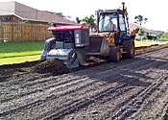
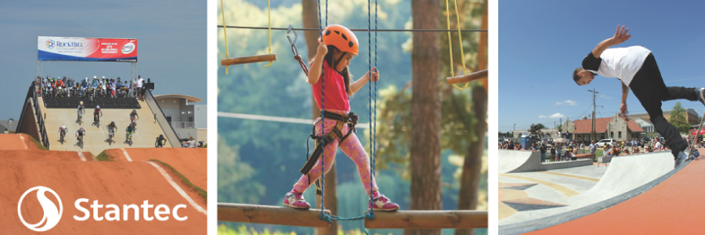
WHAT INTERLOCAL AGREEMENTS EXIST ON IMPACT FEES?
The City of Port St. Lucie and St Lucie County have interlocal agreements for
Libraries,
Parks,
Public Buildings and
Roads.

Slide 4
LIBRARIES AND PARKS
The Library interlocal agreement is dated September 2005. The County will try to use fees collected on development within Port St. Lucie to funds library facilities that benefit the City.
The Parks interlocal agreement is dated September 2011. The County will try to use fees collected on development within Port St. Lucie to fund expansion, construction or debt service for the following facilities:
St. Lucie County Region a I Football-Soccer Stadium Ravenswood Pool,
St. Lucie County Fairgrounds,
Oxbow Eco-Center,
Savannas Campgrounds and
River Park Marina.

Slide 5
PUBLIC BUILDINGS
84% Correction/Detention
16% Court/Constitutionals
The Public Buildings Interlocal agreement was also approved September 2011.
Funds retained by the County shall be expended for capital improvements, land acquisition or debt service payments related to the County's public building needs as follows:
Eighty-four (84%) percent of the collection amount received by the County shall be spent on County correction/detention facilities.
Sixteen (16%) percent of the collection amount received by the County shall be spent on court facilities or county/constitutional officer facilities.

Slide 6
ROADS
The agreement requires the County to inform the City regarding the expenditure of any impact fee funds collected by City and remitted to County and,
where possible, expend the impact fee funds to construct part or all of a road improvement project or for debt service payments for
Midway Road,
Prima Vista Boulevard,
Glades Cutoff Road,
Rangeline Road,
Walton Road and
St. James/ S. 25th Street.
The County is also required to submit an annual report every December indicating the amount of impact fees collected and the expenditure of impact fees for the prior fiscal year.
adopted in September 2011

Slide 7
PORT ST. LUCIE AND ST. LUCIE COUNTY INTERLOCAL AGREEMENT ON ROADS
Requires the County to inform the City regarding the expenditure of any impact fee funds collected by City and remitted to County
Where possible, expend the impact fee funds to construct or pay debt service for six roads
Requires the County to submit an annual report every December indicating the amount of impact fees collected and the expenditure of impact fees.

Slide 8
THE SIX ROADS IN THE INTERLOCAL AGREEMENT
Midway
Prima Vista Boulevard
Glades Cutoff Road
Rangeline Road
Walton Road
St. James/S. 25th Street

Slide 9
ST. LUCIE COUNTY IMPACT FEES COLLECTED IN PORT ST.LUCIE
FISCAL YEAR | ST. LUCIE COUNTY COLLECTION | AMOUNT COLLECTED ON PSL DEVELOPMENT
FY 2015 | $ 4,712,684 | $1,760,131,.23
FY 2016 | $4,956,957 | $3,393,501.44
FY 2017 | $4,925,460 | $3,989,873.50
FY 2018 | $7,637,907 | $5,909,129.67
FY 2019 | $10,242,284 | $7,542,487.49
TOTAL | $32, 75,292 | $22,595,122.

Slide 10
PERCENTAGES OF NOTE
Port St. Lucie comprises over 60 percent of St. Lucie County.
Development within Port St. Lucie accounts for 69 percent of the all St. Lucie County Impact fees collected between FY 2015-16 through FY 19-20.

Slide 11
ALLOCATION OF IMPACT FEE FUNDS, FY 15-16 THROUGH FY 19-20
Fees spent on roads by Fiscal Year | FY 15-16 | FY 16-17 | FY 17-18 | FY18-19 | FY 19-20
Roads listed in the Interlocal | $15,706,766 | $9,788,033 | $2,011,306 | $2,009,526 | $457,380
Other Roads | $2,667,218 | $8,763,201 | $3,389,104 | 00.00 | $6,918,485

Slide 12
TWO OF THE SIX ROADS IN THE INTERLOCAL AGREEMENT RECEIVE NO IMPACT FEE FUNDING
Rangeline Road
Walton Road

Slide 13
$22.5 MILLION DOLLAR$
St. Lucie County IMPACT FEE RESERVES

Slide 14
ALLOCATION OF PARKS IMPACT FEE FUNDS, FY 15-16 THROUGH FY 19-20 PARKS
Fees spent on parks by Fiscal Year | FY 15-16 | FY 16-17 | FY 17-18 | FY 18-19 | FY 19-20
Parks listed in Interlocal |  | $480,000 | $400,000 | $977,134 | $144,766
Other Park Facilities | $97,283 | 332,159 | $136,116 | $313,568 | $1,319,084

Slide 15
BAC RECOMMENDATIONS
The Port St. Lucie Budget Advisory Committee reviewed the White paper on St. Lucie County’s use of Impact Fees collected on development in the Port St. Lucie, at its meetings on October 21, November 4, and November 18, 2020.
BAC will present its recommendations to the City Council
at its December 14, 2020.

Slide 16
QUESTIONS?
Port St. Lucie
City Council
December 14, 2020

